Slide 1
HOSPITAL MANAGEMENT SYSTEM
HOSPITAL MANAGEMENT SYSTEM

Slide 2
ABSTRACT
Hospital management system is a project which aims in developing a computerized system to maintain all the daily work of hospital.
It has a facility of admin login through which the admin can monitor the whole system.
Admin modules are manage patients , manage doctors and manage appointments.
Overall this project of ours is being developed to help the hospital administration , maintain the hospital management in the best way possible and also reduce the human efforts.

Slide 3
MODULES
Manage Patients (ADD , VIEW ,REMOVE , EDIT )
Manage Doctors
Manage Appointment

Slide 4
FRONTEND (LANGUAGE USED)
HTML
CSS

Slide 5


BACKEND (LANGUAGE USED)
MySQL
BOOTSTRAP

Slide 6


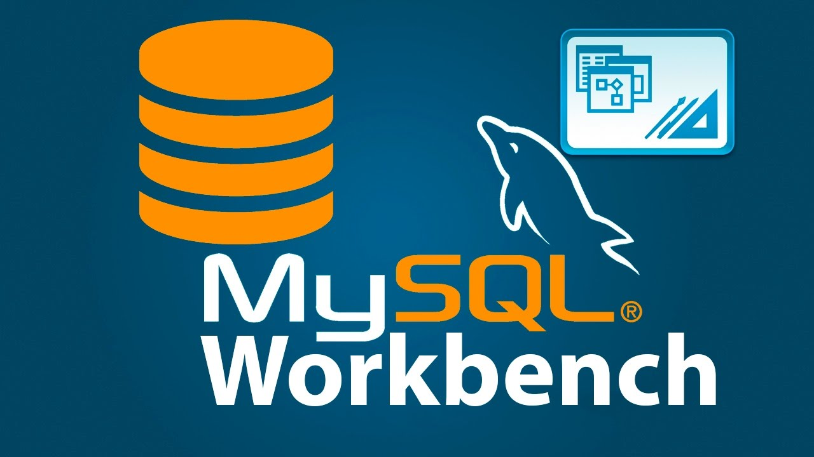
API USED
Eclipse-Jee-Neon
JDK 8u221
MySQL WorkBench

Slide 7
Objective Analysis
Admission: patient admit in hospital.
Patient details: patient bio data.
Doctors: Doctor details + appointment.
Staff: Nurse on duty & recptionist,accountant.
Consultation: Diagnosis treatment & medicine.
Bill: Billing of out patient

Slide 8
USE CASE DIAGRAM
General Use Case :- Now I present to you the general use case of the Hospital Management System. This diagram shows the general processes or function that the system could do that is based on the transactions done by the patient and physician whether its is admission or consultation.

Slide 9
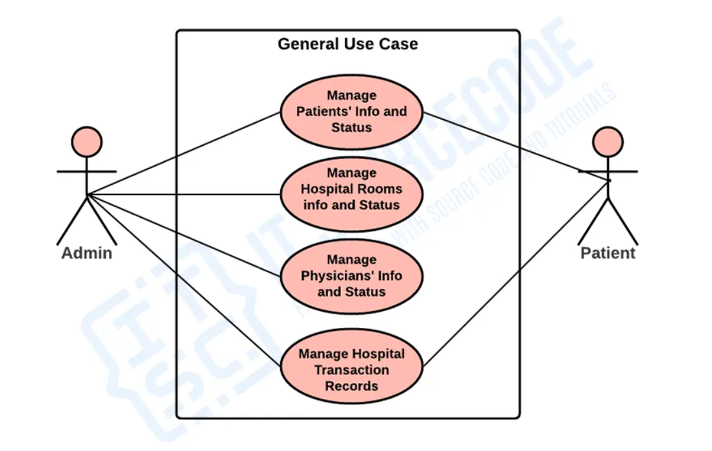

Slide 10
Contd…
Monitor and Manage Patients’ Information and Status :-This is where the admin or the main user of the system could have access into the patient information in terms of availing the hospital services. The patients’ information must be composed of their basic data, sickness complaints or consultations including admission. These data were then recorded and given to the appropriate physician for curing and basis for the kind of services to be done.

Slide 11
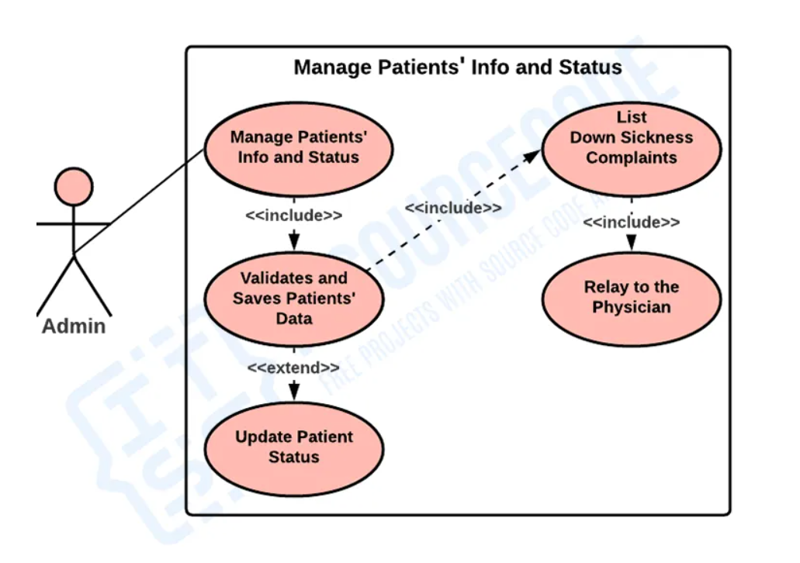

Slide 12
Contd…
Manage Hospital Rooms and Physicians’ Info and Status :-This is the process where the admin checks and update the room information and status because is important for patient admission. It is important to secure the rooms before admitting the patients because the patients must put into delicate care. By this process, the admin will organize the processes during the patient admission.

Slide 13
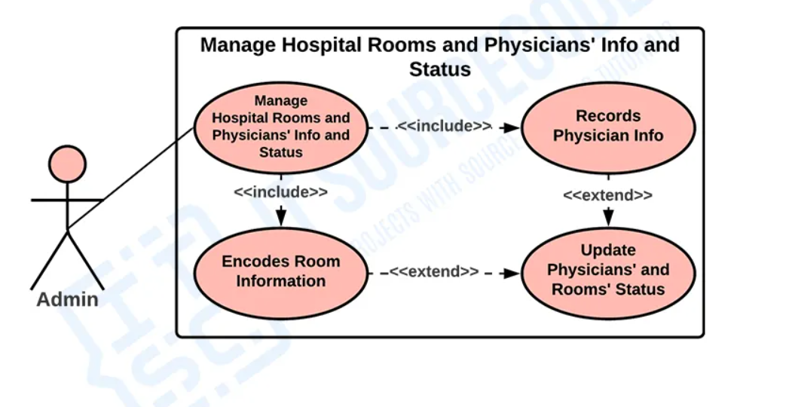

Slide 14
Contd….
Monitor Hospital Transaction Records :-This process explains about how the admin or users handles transaction made by the physician and the client. These transactions were composed of the patients’ information and sickness complaints and the physician that has accommodated that patient, the prescription provided and the total payment of the said transaction.

Slide 15
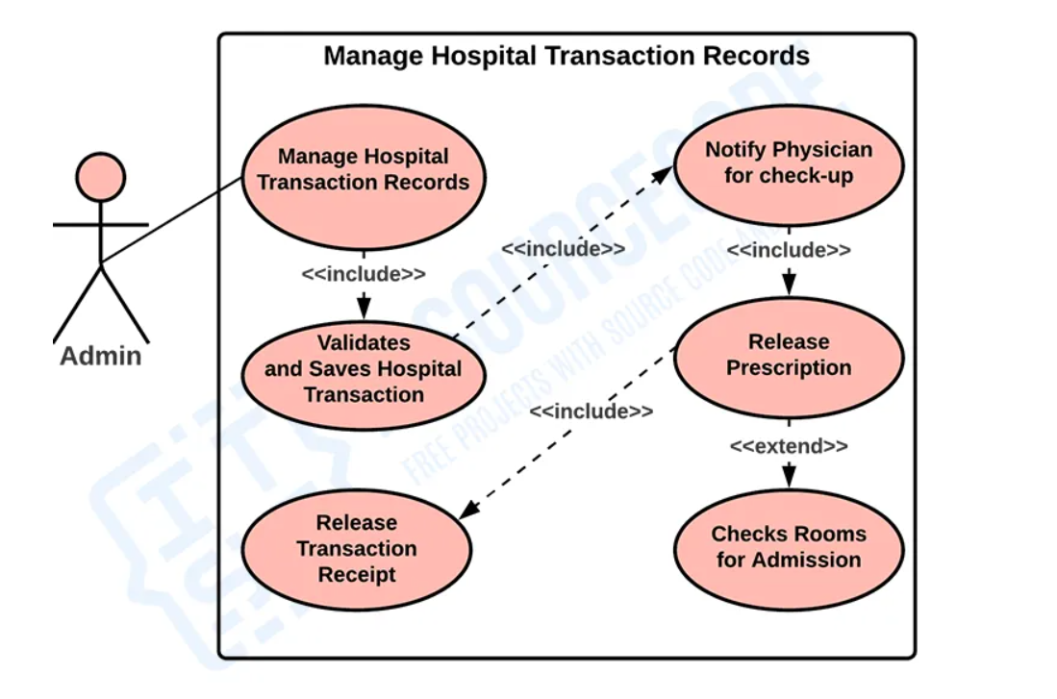

Slide 16
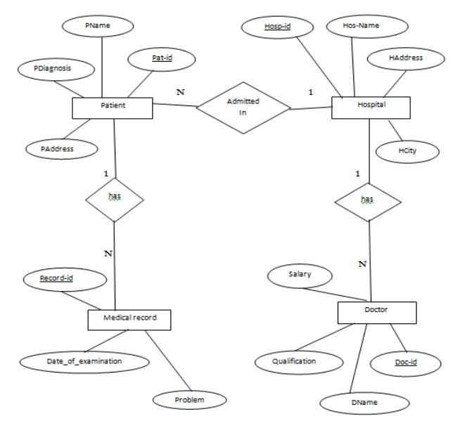
ER DIAGRAM

Slide 17
Converting the E-R Diagram into Tables
Hosp-id | Primary Key
HCity
HAddress
Hos-Name
Pat-id | Foreign key references to Pat-id of Patient table
Doc-id | Foreign key references to Doc-id of Doctor table

Slide 18
Patient
Pat-id | Primary Key
PName
PAddress
PDiagnosis
Record-id | Foreign key references to Record-id of Medical Record table
Hosp-id | Foreign key references to Hosp-id of Hospital table

Slide 19
Medical Record
Record-id | Primary Key
Problem
Date_of_examination
Pat-id | Foreign key references to Pat-id of Patient table

Slide 20
Doctor
Doc-id | Primary Key
DName
Qualification
Salary
Hosp-id | Foreign key references to Hosp-id of Hospital table

Slide 21
CLASS DIAGRAM
It resembles a flowchart in which classes are represented as boxes with three rectangles inside each box. The top rectangle has the class’s name; the middle rectangle contains the class’s properties; and the bottom rectangle contains the class’s methods, commonly known as operations.

Slide 22
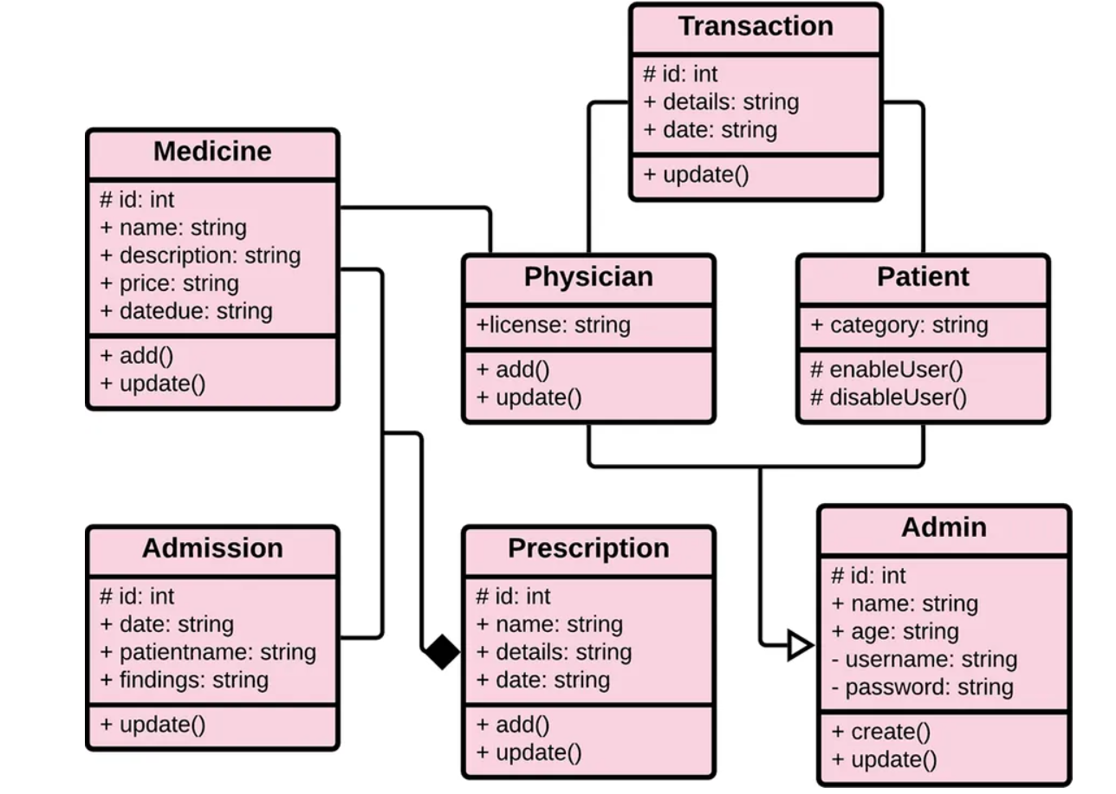
Contd….

Slide 23
Conclusion
The project hospital Management System (HMS)is for computerizing the working in a hospital .the software takes care of all the requirements f an average hospital and is capable to provide easy and effective storage of information related to patient that come up to the hospital.
It generates test report ; provide prescription details including various tests ,check-up and medicines prescribed to patient and doctor .it also provides injection details and doctor .it also provides injection details and billing facility.
The system also provides the facility of backup as per the requirement

Slide 24
Output Result
Patient diagnosis &test record.
Patient treatment result card.
Output patient bill deposit.
Patient discharge certificate.

